Slide 1


Slide 2
Objectives Streaming Analysis
Visually understand whether most of the incidents meets SLA or breaches SLA
The reason for most of the breaches, and dependency on other columns
Incident Trend analysis
Focused around identifying peak hour of the day and peak day of the week.
Identify the relationship between SLA breach and incident volume.
Suggest countermeasures, and derive insights from the data.

Slide 3
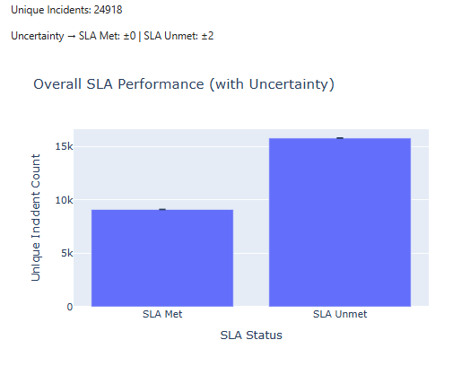
SLA compliance Analysis
More incidents breached SLA target
Around SLA UNMET = 1.7xSLA met
Uncertainity_met = |C_current,met – C_previous,met|
Defines uncertainity over a period of longer time,
Arises from the fact that the reason for breach is possibly improper assignment, high overload.

Slide 4
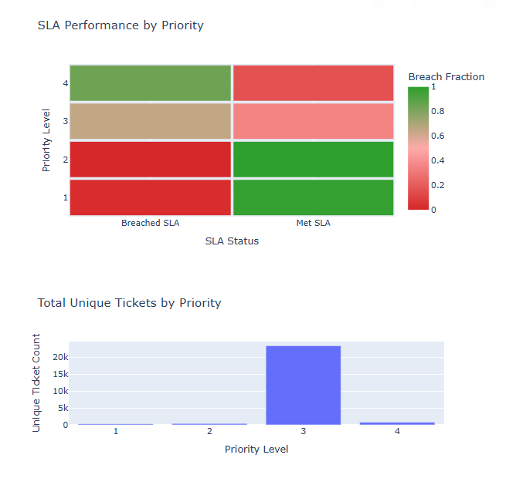
Effect of Priority on SLA Compliance:
Higher the priority (Lower integer) more SLA targets are met.
Lower the priority (Higher integer) more SLA breaches happens.
Uncertainty(p,sl a) = |count(current) −count(previous)|
0, 1, 2 lower uncertainity suggests incidents resolved immediately.
Color is determined by fraction
Fraction(met) = N(met,p) / N(p)
Fraction(unmet) = N(unmet,p) / N(p)
Fraction(met,p) + Fraction(unmet,p) = 1

Slide 5
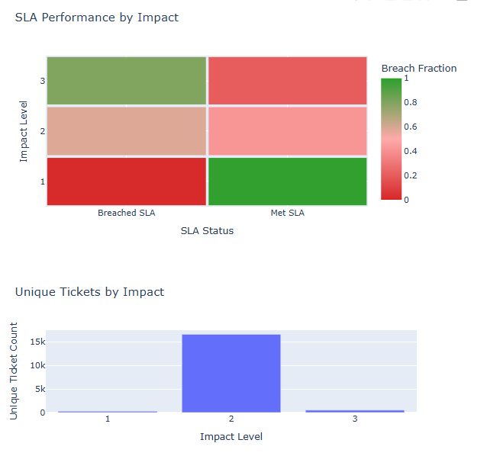
Effect of Impact on SLA Compliance:
Higher the impact (Lower integer) more SLA targets are met.
Lower the impact (Higher integer) more SLA breaches happens.
Uncertainty(i,sl a) = |count(current) −count(previous)|
0, 1, 2 lower uncertainity suggests incidents resolved immediately.
Color is determined by fraction
Fraction(met) = N(met,p) / N(p)
Fraction(unmet) = N(unmet,p) / N(p)
Fraction(met,p) + Fraction(unmet,p) = 1

Slide 6
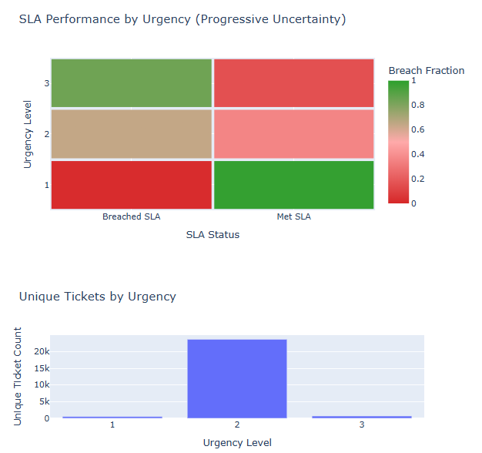
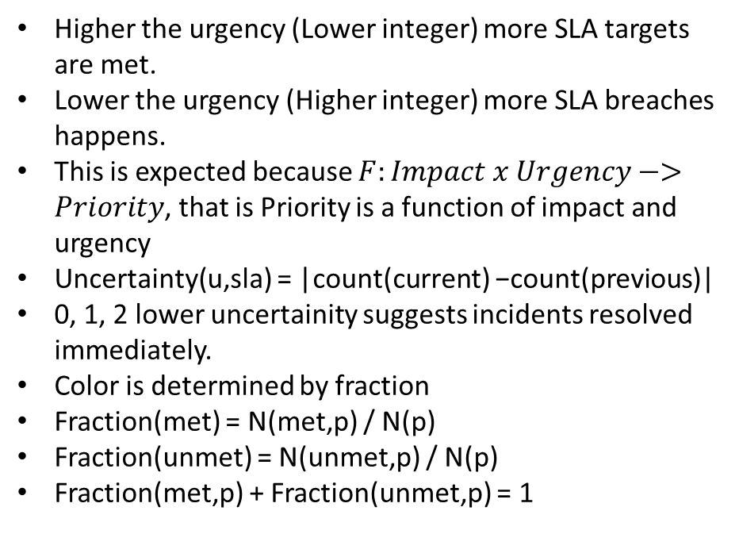
Effect of Urgency on SLA Compliance:

Slide 7
Insights from Heatmap
Higher severity(priority, impact,urgency) less SLA breaches
Lower severity, higher SLA breaches.
High severity incidents are lower in number
Low,and medium severity incidents are higher in number.
What is causing the SLA breach?
Is it performance limitation of assigned group or workload distribution, or both?

Slide 8
Group capability score
Score_of_1_incident = 10/log(priority + impact + urgency)
Total_score = sum of all sla_met – beta*sum_of_all_sla_unmet
We define beta empirically to smooth out graph visualization, we find 0.15 works well.
Uncertainity = |score(current) – score(previous)|
Unchanging or low score changes suggests stable group performance.

Slide 9
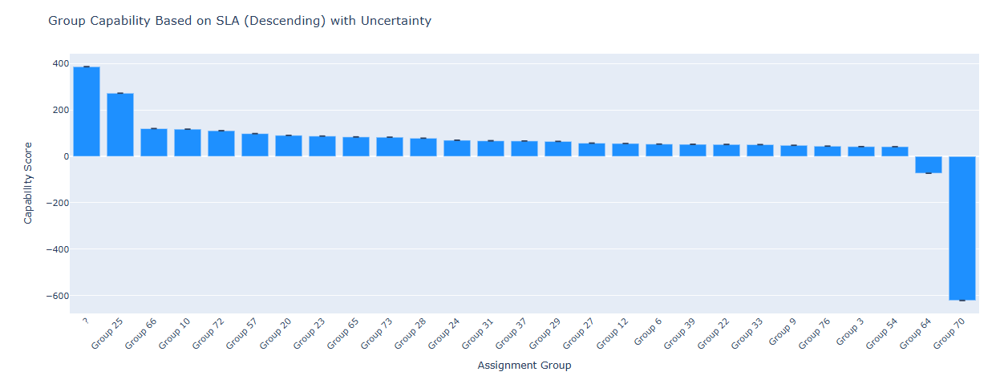
Group Capability Score

Slide 10
Group capability score
Initially group 70, performed well, but with increasing workload (around 9500 incidents assigned to group 70), its performance significantly decreased.
Group 64 is underperforming, it needs to be re-evaluated and replaced.
New way of workload assignment, required like epsilon-greedy.
Most of the groups have around 50% of incidents meeting SLA.

Slide 11
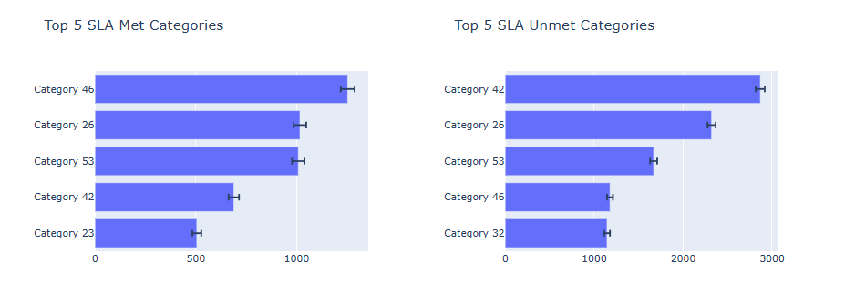
Top 5 categories by SLA compliance
Category 42,53,26,and 46 contributes majorly to breaching SLA compliance and meeting SLA compliance
We can train dedicated groups on these categories to increase SLA compliance.
To convey uncertainty we use bernouli trial’s standard error

Slide 12
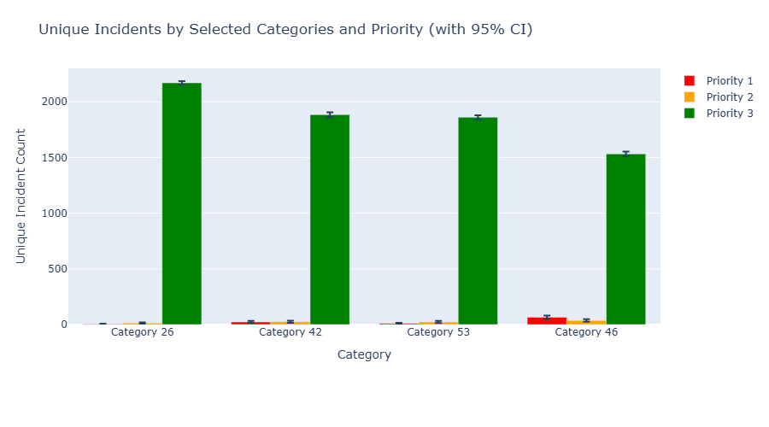
Priority Distribution Among Major Categories
Priority 3 incidents are the highest in number
Train dedicated groups for priority 3 incidents.
Uncertainty is conveyed through 95% confidence interval.

Slide 13
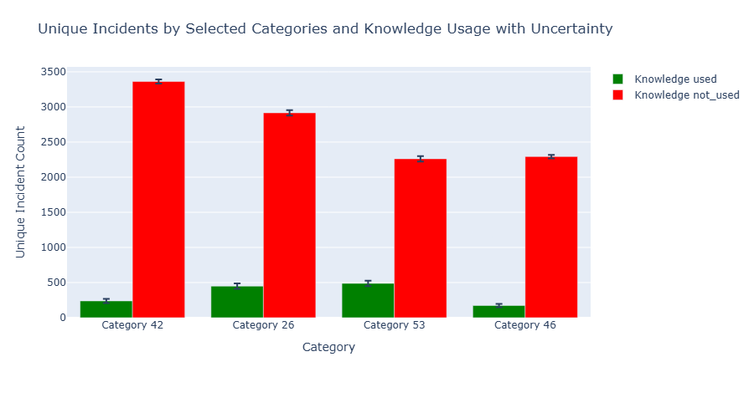
Knowledge base usage across major categories.
For all the major categories, for most of the incidents knowledge base was not used, either because it was non-existing or difficulty in locating it.
But does knowledge base impacts SLA breaches ? Intuitively yes, but we need to verify this from data.

Slide 14
Impact of Knowledge usage on SLA compliance
Contingency matrix
Odds ratio = (a/b) / (c/d) = a.d/b.c
Relative probability = (a/(a+b)) / (c/(c+d))
OR > 1 suggests knowledge base usage increases the odds of meeting SLA.
RP > 1 suggests knowledge base usage increases the probability of meeting SLA.
 | SLA met | SLA unmet
KB Used | a | b
KB unused | c | d

Slide 15
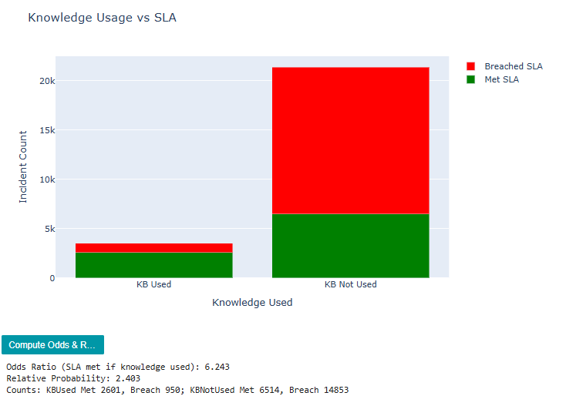
Impact of knowledge usage on SLA compliance
Usage of knowledge base increases the odds of SLA compliance by 6 times
If knowledge base is used for the incident it is 2X more likely to meet target SLA.
Thus training a dedicated group and instructing them to make RCA on incidents will make more incidents meet target SLA.

Slide 16
Trend Analysis
We aim to identify specific day in week, or hour in a day where incident volume peaks
This will help us identify the reason for incidents, and help us with resource allocation strategy.
We first start by a box plot where we will find out the day where incident volume peaks.

Slide 17
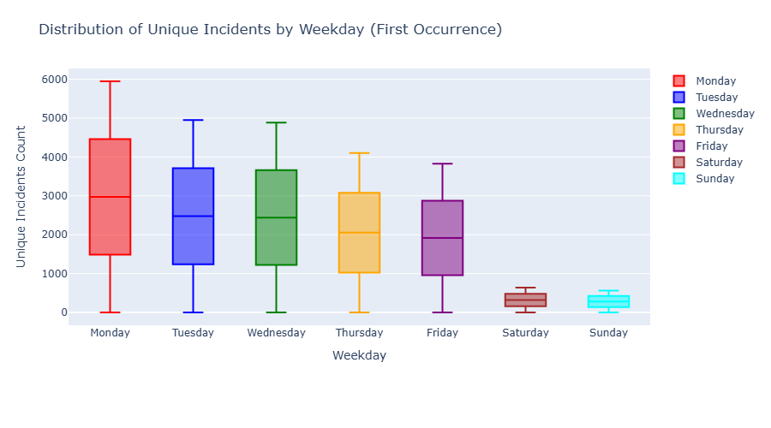
Incident distribution by day of week
Monday has the highest number of median incidents.
Tuesday and Wednesday has almost similar volume of incidents
Followed by Thursday and Friday.
Weekends has minimum number of incident volumes.
Possible explaination : Operational activity peaks during start of the week, and as system stabilizes over the week incident volume decreases. Weekends are holidays so there is reduced business operations, most of the incidents are due to internal changes by teams

Slide 18
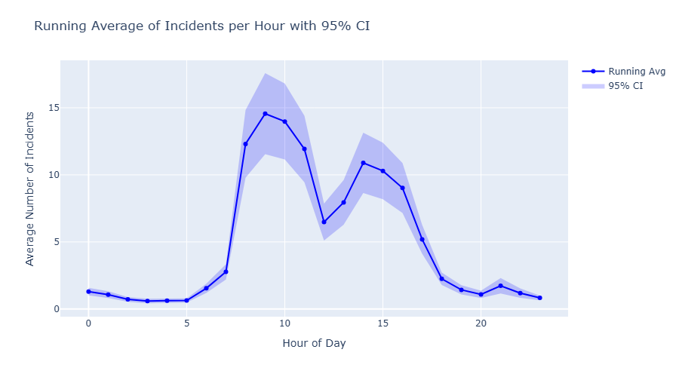
Running average of incident distribution by hour of day
Incident volume peaks at 8.00-11.00 and 13.00-16.00
Uncertainty is conveyed using 95% confidence Interval.
Strategic allocation of more active resource during these hours in weekdays can help with more SLA adherence.
The peak volume at working hours is an indication between operational activity and incident. Whereas reduced incident average between 11.00-13.00 suggests organizational breaks like lunch break.

Slide 19
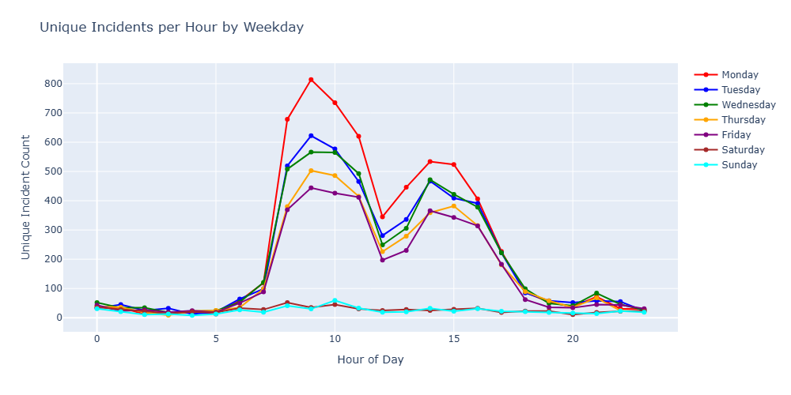
Hourly Incident Distribution by Weekday
We verify the running average trend across all days of the week,
We plot incident count for each hour for each day across all the weeks.
We see that the trend line is similar only the amplitude decreases, adhering with our box plot.
Thus this confirms the pattern described using running average, and the relation of incident occurrence to operational activity, and our previous suggestion of having dedicated team to solve incident and deploying them at particular time of the day for more SLA compliance.

Slide 20
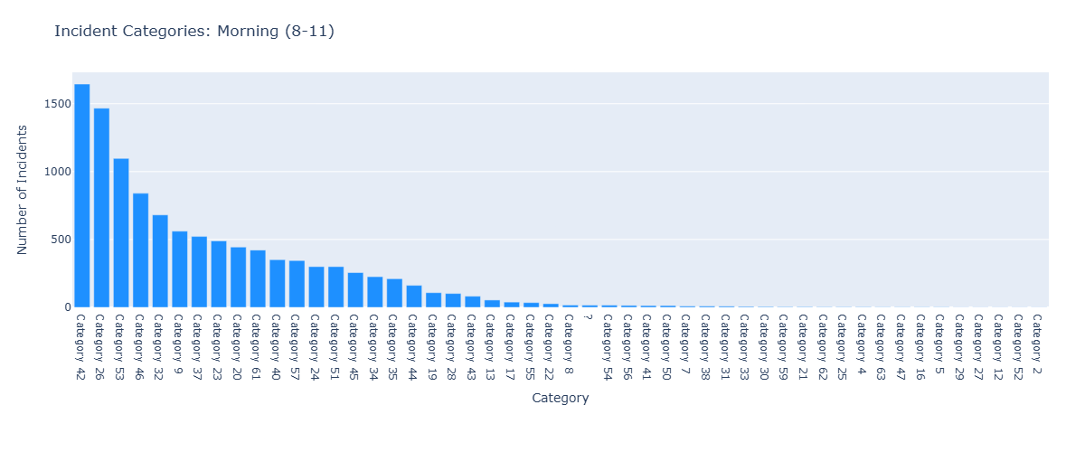
Category Distribution During Peak Incident Hours

Slide 21
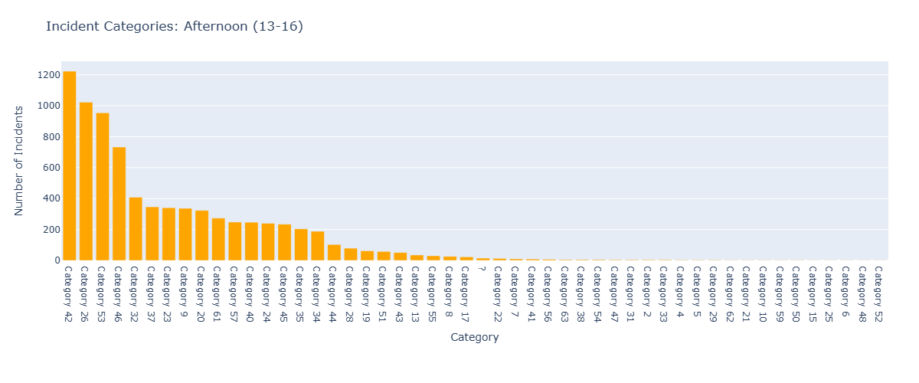
Category Distribution During Peak Incident Hours

Slide 22
Category Distribution During Peak Incident Hours
We see that between 8.00-11.00 and 13.00-16.00, incident of category 42, 46, 53, and 26, occurs many times.
This supports our intuition from SLA compliance where we suggested to train dedicated group on category 42, 46, 53, and 26 and allocating them during peak hours will help more incidents meet sla target.

Slide 23
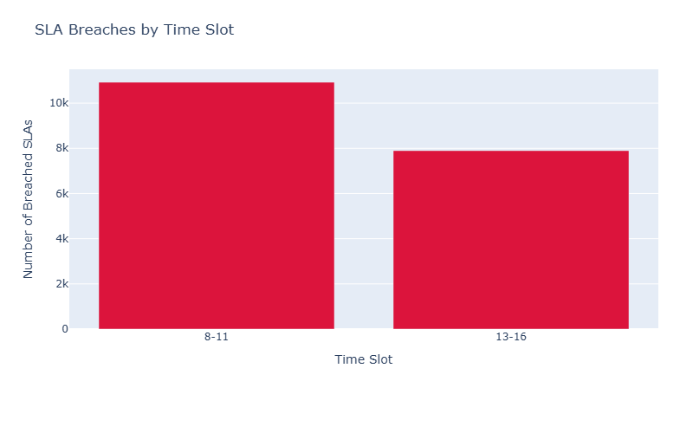
SLA Breaches by Time of Day
We want to identify when SLA breaches happens mostly Morning session or Afternoon session.
We see that sla breaches are proportional to the incident volumes
To tackle this, providing additional resource during the morning session (8.00-11.00), will help with SLA adherence.

Slide 24
Forensic Analysis Objectives
• Identify structural drivers of resolution delay
• Evaluate impact of escalation depth on SLA breach
• Validate SLA hierarchy assumptions
• Detect temporal anomalies
• Reveal latent structural clusters using PCA

Slide 25
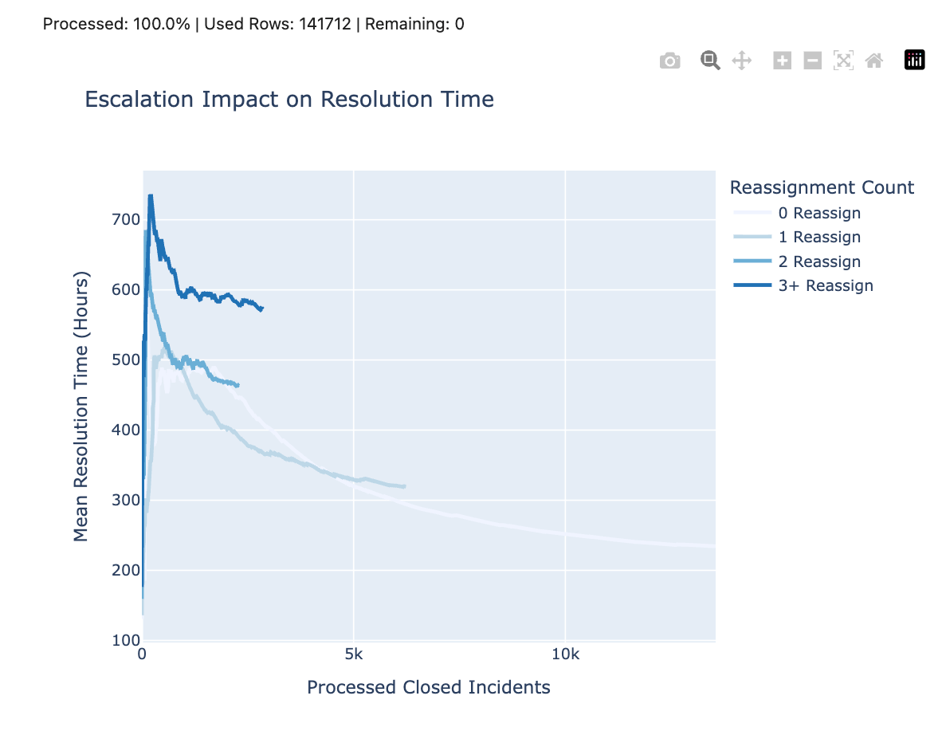
Escalation Impact on Resolution Time
Key Findings:
• Resolution time increases monotonically with reassignment_count • Incidents reassigned ≥3 times show significantly higher median resolution • Clear structural inefficiency pattern
Interpretation:
Repeated handoffs introduce:
Coordination overhead
Communication delays
SLA timer continuation
Conclusion:
Escalation depth is a major operational bottleneck.

Slide 26
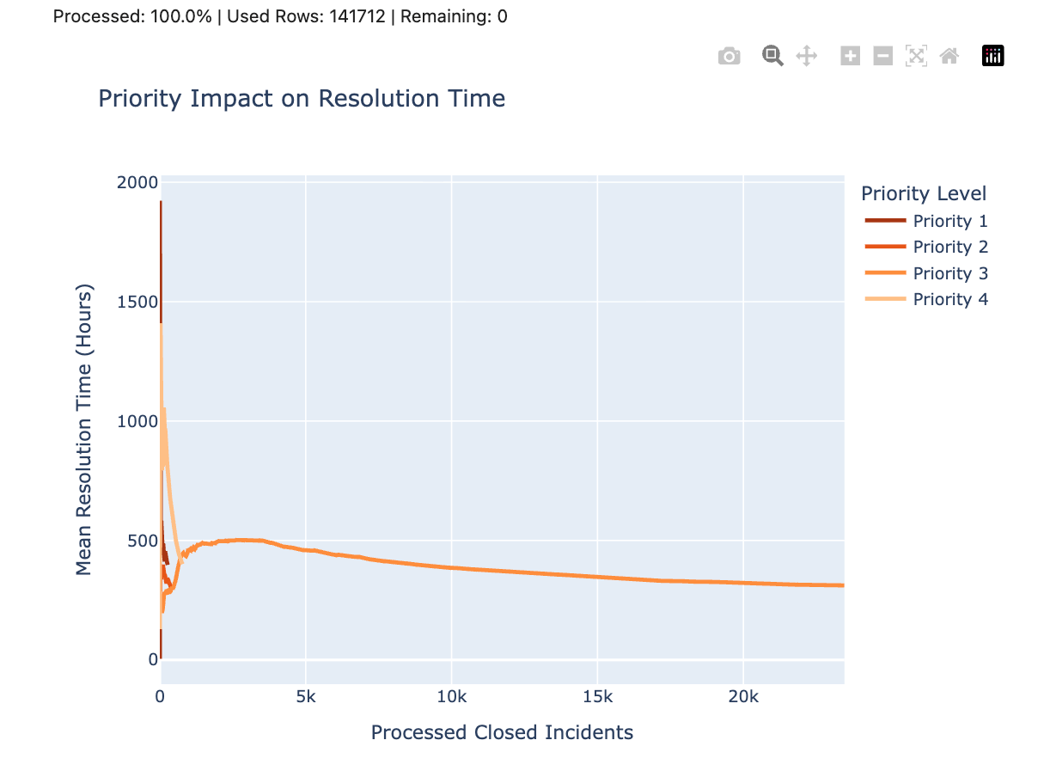
Priority-Level Performance
Expected:
Priority 1 should resolve fastest.
Observed:
Priority 1 does NOT consistently resolve faster than Priority 2.
Implications:
• Possible workload saturation • Increased complexity in high-priority cases • Structural bottlenecks in critical incident handling
This triggered deeper forensic investigation.

Slide 27
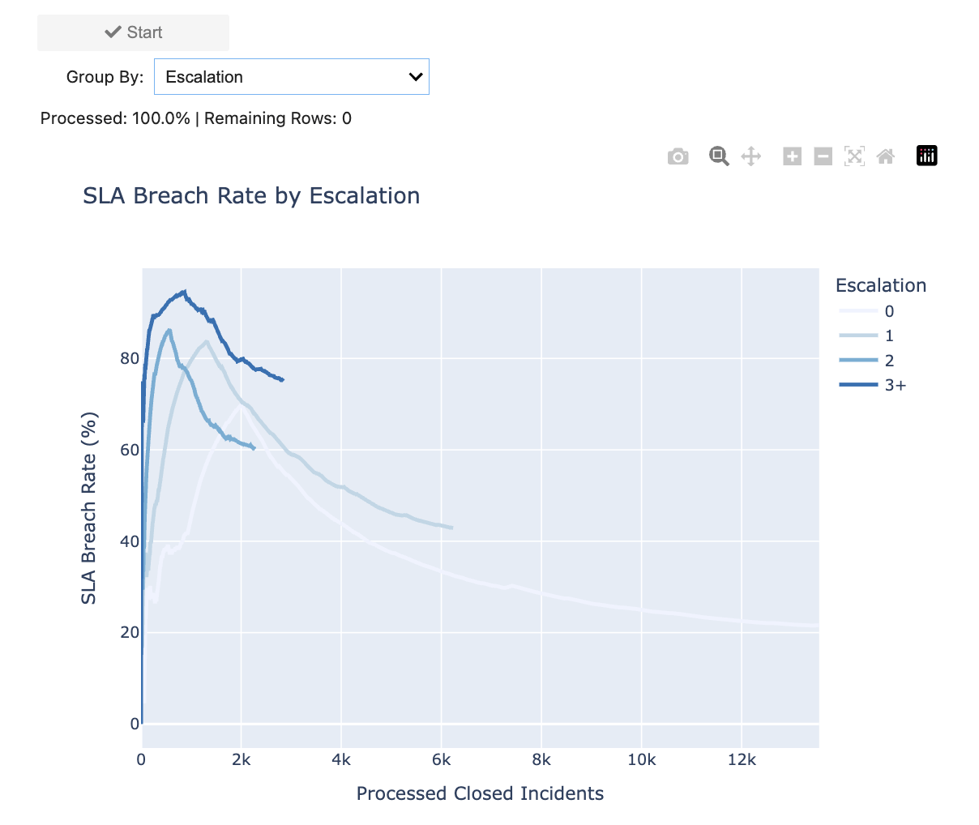
SLA Breach vs Escalation Depth
Findings:
• SLA breach probability increases with reassignment_count • Multiple escalations strongly correlated with SLA failure
Insight:
Escalation affects BOTH:
Resolution time
SLA compliance
Structural inefficiency confirmed.

Slide 28
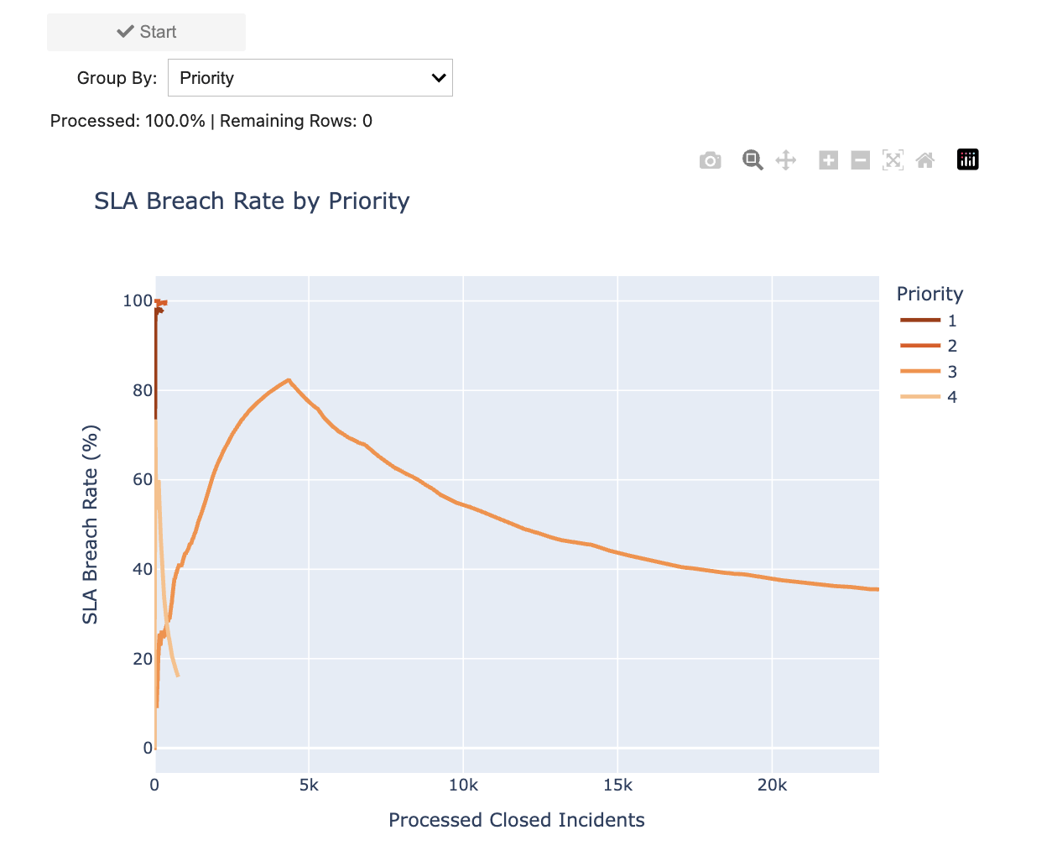
SLA Breach by Priority
Key Observation:
• Breach rates remain high across ALL priority levels • Even high-priority incidents breach SLA frequently
Interpretation:
Problem is NOT just urgency classification It indicates systemic workflow inefficiencies.

Slide 29
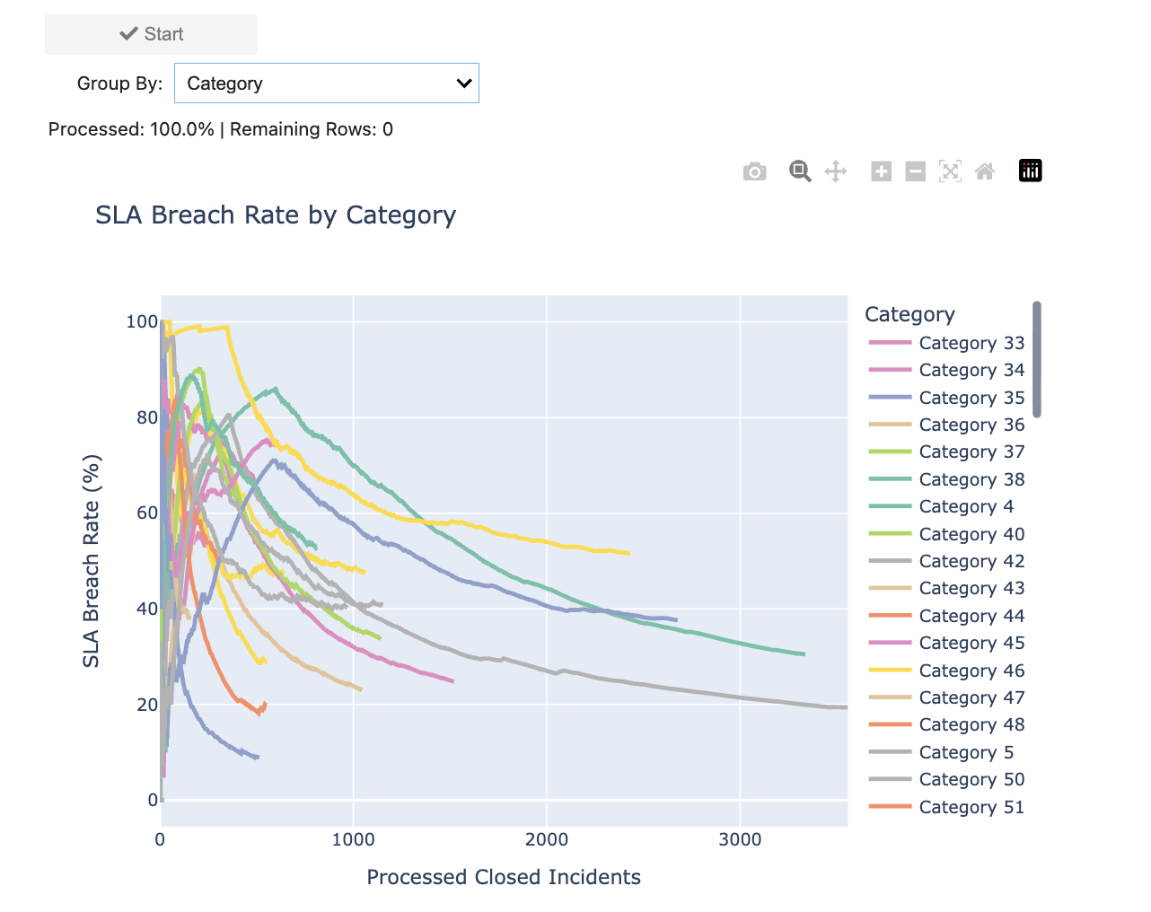
SLA Breach by Category
Findings:
• Certain high-volume categories show disproportionately high breach rates • Indicates localized workflow bottlenecks
Operational Recommendation:
• Assign specialized teams • Optimize category-specific workflows

Slide 30
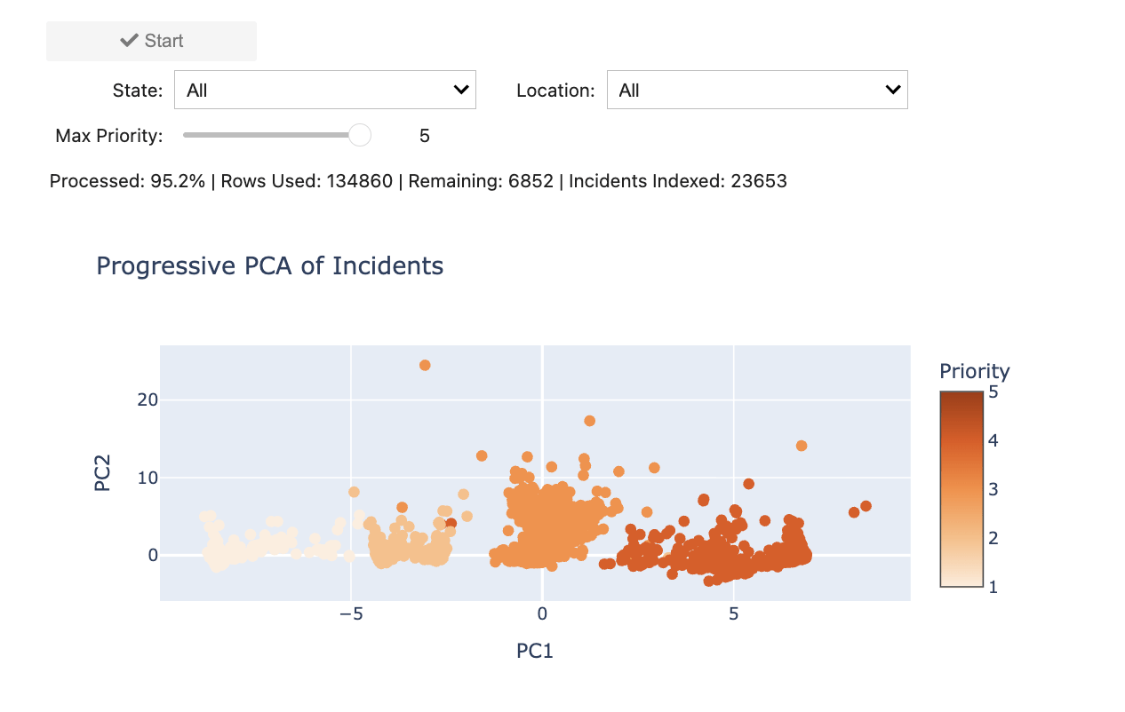
Dimensionality Reduction (PCA)
Applied PCA on:
[reassignment_count, reopen_count, sys_mod_count, priority, impact, urgency]
pc1 - overall incident complexity
pc2 - escalation vs urgency trade off
Why?
To detect latent structural patterns in incident behavior.
Result:
• Incidents form structural clusters • Routine cases cluster tightly • High-complexity incidents spread out
Insight:
Incident behavior lies on correlated operational manifolds, not random variation.

Slide 31
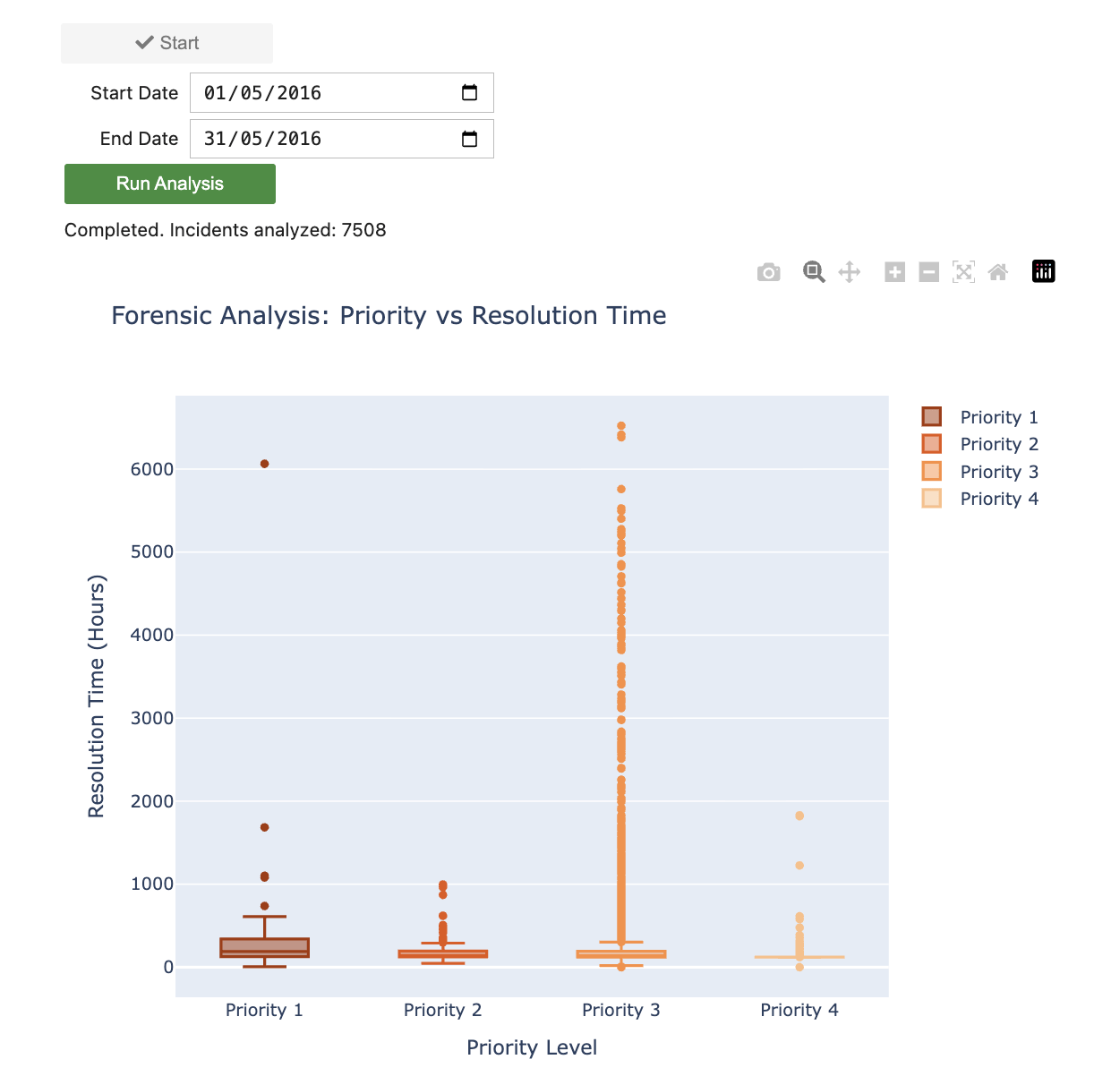
May 2016 Anomaly
Observation:
Priority 1 median resolution = 190 hours Priority 2 median resolution = 141 hours
This violates SLA expectation.
Interpretation:
Localized operational anomaly.

Slide 32
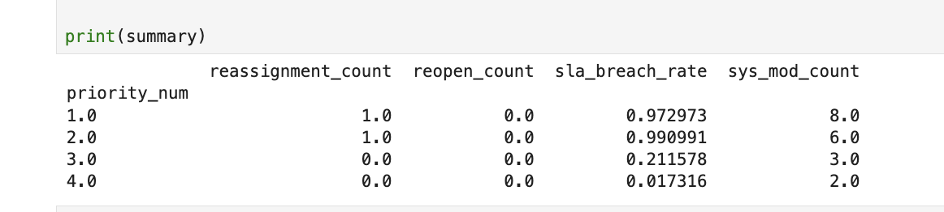
Root Cause Analysis (May 2016)
Investigated:
• Escalation depth → Normal • Reopen count → Normal • sys_mod_count → Elevated
Interpretation:
Higher workflow modification intensity Indicates internal coordination strain
Likely systemic overload during May 2016.

Slide 33
Forensic Conclusions & Impact
Root Cause – May 2016 Anomaly
Escalation depth and reopen cycles remained stable Elevated sys_mod_count indicated increased internal coordination complexity
Evidence suggests temporary systemic workload strain, not escalation mismanagement
Structural Insights from Forensic Analysis
Escalation depth strongly increases resolution time and SLA breaches
Priority classification does not guarantee faster resolution
SLA violations are distributed across categories, indicating systemic inefficiencies
PCA revealed latent structural clusters driven by operational complexity
Operational Implications
Reduce unnecessary reassignment cycles
Introduce category-specific workflow optimization
Improve monitoring of complexity indicators (e.g., sys_mod_count)
Use progressive visual analytics for early anomaly detection

Slide 34


